Slide 1

A Humanistic Perspective on the Discourse of Evidence-Based Practice in the Mental Health Literature:
The Case of Psychiatric Music Therapy
Brian Abrams, Ph.D., MT-BC, LPC, LCAT, FAMI

Slide 2

Evidence
Random House (n.d.) defines it as “That which tends to prove or disprove something; ground for belief; proof” as well as “Something that makes plain or clear; an indication or sign.”
American Heritage (n.d.) defines it as “A thing or things helpful in forming a conclusion or judgment” and as “Something indicative; an outward sign.”
Webster’s (n.d.) defines it as “That which makes evident or manifest; that which furnishes, or tends to furnish, proof; any mode of proof; the ground of belief or judgment; as, the evidence of our senses; evidence of the truth or falsehood of a statement” as well as “one who bears witness.”

Slide 3
Evidence (Consolidated)
Indications, manifestations, and/or signs that serve as sufficient grounds for beliefs, judgments, formation of conclusions, or proof about a given phenomenon, by bearing witness to, and making plain or clear, certain aspects of that phenomenon

Slide 4
Evidence-Based Practice
According to the principles of EBP (Cochrane, AHRQ, etc.), as currently applied to the majority of mental health research and work…practice should:
be based upon sufficient grounds (aligning with the general definition of evidence given above), rooted in both research findings and the clinical expertise of the practitioner
target processes and outcomes that are valuable (i.e., effective and/or meaningful) both from a disciplinary stance and from the patient’s (client’s) point of view
involve various levels of participation and collaboration with the patient (client)

Slide 5
Two Contrasting Epistemological Domains of Evidence in Mental Health Practice
Accommodated by General Definition of EBP
OBJECTIVE “It Works” The True Science Behavioral | SUBJECTIVE “I Work” The Beautiful Humanities Intentional

Slide 6
Science as Literary Discourse
Narratives explicated from within the disciplines of psychiatry and psychology, telling stories about the biomedical, behavioral, and/or social “facts.”
Guided by principles and values centered upon causality, control, and prediction
The characters and subjects are consist of standardized, quantitative, objective variables of observable characteristics (i.e., DSM-IV-TR)
Fiction/metaphor is “construction” and is “false”
The narrative of science cannot accommodate the emergent holism and agency of humanism

Slide 7
Principles of Humanism
Primacy of the Whole Person
  Whole person precedes and transcends parts (it has its parts--body, brain, psyche, etc.—but is not its parts)
  Parts of a person are only meaningful in relation to the whole person
  Whole is unconditional, and unconstrained by conventional “ability”
  Maslow hierarchy, inverted!?

Slide 8
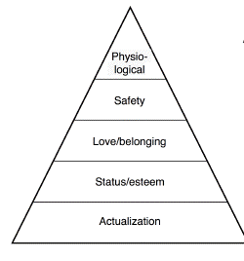
Inversion of Maslow’s Hierarchy of Needs
(Martin Börjesson, 2006)

Slide 9

Principles of Humanism
Personal Agency
  Persons are not effects of causes—persons, as agents, utilizeopportunities for being
  “Choice” is not a cognitive act only—it is a human act, and a way of being—it is not constrained by conventional “ability”

Slide 10
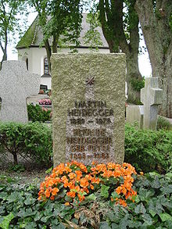
Principles of Humanism
Relationship
  Being Together (Da-Sein = Mit-Sein, Heidegger)
  Being a person means to exists in relation—not merely having a body, or psychological contents. Persons are the individual and collective meaning of a person
    Memorials are for the bereaved, by being for the deceased’s meaning-in-relation

Slide 11
EBP from the Perspective of the Health Humanities, and Based on Principles of Humanism
When participants work together through the humanities to promote health, guided by grounds sufficient to help ensure that the work is valuable

Slide 12

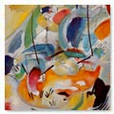
Principles of Humanism
Applied to Art
Way of being-together, aesthetically
  standing in relationship to the beautiful
  involving both creativity and imagination
Holistic essence
  transcends its parts
  Transcends its medium
Requires agency and intentional participation
  must be both created and construed humanly
  must also be created and construed humanely (“aesthethics”)

Slide 13


Principles of Humanism
Applied to Music
A way of being-together, aesthetically, in time
  Through various types (listening, composing, performing, improvising)
  Through various elements (rhythm, melody, harmony, etc.)
  Musica Humana vs. MusicaInstrumentalis (Boethius, c. 1491)
  Dance as a form of music (!)
Notes:
Musica Humana is deeper, human manifestation of music, from humanistic perspective. MusicaInstrumentalis, or what we conventionally understand as “music,” is actually an ideal, concrete, physical sound-based expression (analogy) of humana, but is not itself the core of music. It is the harmony of the human body, mind, soul. Taken here as an understanding that supports music as being-together, aesthetically, in time, beyond the concrete sound form.
By this definition, dance would count as a specific form/expression of music (spatial and temporal dimensions—in its concrete expression, like musicainstrumentalis, but with movement in place of sound)

Slide 14

Music Humana
Boethius (15th Century Depiction)

Slide 15
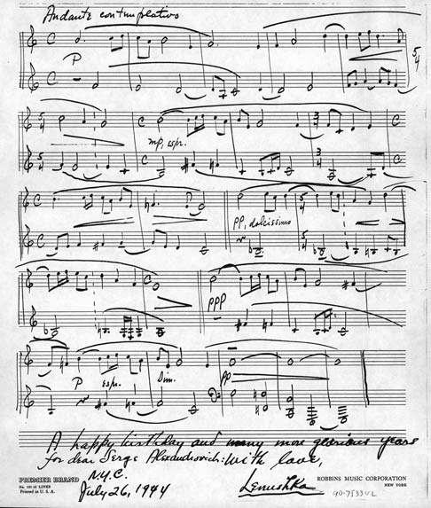
Principles of Humanism
Applied to Music
Holistic Essence
  Transcends its parts
  Elements meaningful
  with respect to whole
  Transcends its
  medium (sound)
Notes:
Segments and Elements relate to the whole, through time…it refers to past and future as it unfolds—cannot be treated in isolated moments…The music is “located” in its wholeness—cannot be dissected without it ceasing to be what it really is
Musica Humana not bound to a physical sound form
Consider Silence; hearing sound AS music; hearing “music” as sound object….Can MOZART NOT BE MUSIC? Well, if not in context of being with then is like being heard by a CAT (or any non-human)!

Slide 16
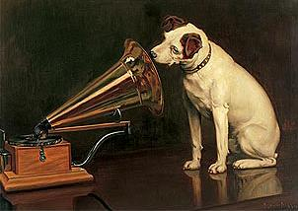
Principles of Humanism
Applied to Music
Agency and Intentionality are Required
  Participation with aesthetic intentionality, including listening/hearing, is part of what makes it music
  If a dog listens to Brahms, is it really Brahms?
Notes:
Person with 0 IQ in vegetative state is no more like the cat than any person—any person may treat the music as sound object, but if in context of being together, and if it is the individual and collective meaning of a person that makes her/him a person, then the music is music!!!

Slide 17
Principles of Humanism
Applied to Music
  Not a stimulus object nor a technical process—but rather an artistic process (musician is not a technician). It can only be music by virtue of a fully human experience of participating in a whole art process.
  The brain does not process music—a person does, as it always takes a person to encounter art…Art, and music, is not “located” anywhere else but in person-hood!
  Neurophysiology is but a medium for person-ness, just as sound can be a medium for music (as in MusicaInstrumentalis)

Slide 18
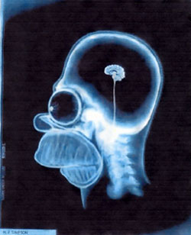
…In short, music is a NO-BRAINER

Slide 19
Humanistic Music Therapy
Working through music, with Unconditional Positive Regard, in support of agency, identity, dignity, authenticity, personal meaningfulness—promoting health as ways of being together in healthfully aesthetic ways
Therapeutic relationship is not just one component or “factor” of therapy—it IS the therapy, insofar as the therapy is humanistic

Slide 20
Humanistic Music Therapy
Music therapist is not a technician that manipulates musical objects and health objects (“You are your own best technique” – Corey)
Expertise surpasses physician/psychologist-musician or music-neuroscientist because of unique training in the capacity to be-with-others, and to construe all interaction, processes, even “talk,” musically
“Musical Therapy” … Musica Humana transcends musical sound
Music as domain of health: Music as aesthetic way of being in time is already a form of health. The creativity, imaginativeness, playfulness, etc., is already embodied well being, applying to many areas of conventionally understood “health.”
Notes:
“MUSICAL THERAPY” IS NOT Really SUCH AN INSULT afterall: Music therapist's expertise is to do therapy musically (with musicainstrumentalis as expression of music humana), not to manipulate music for therapy
Even the "thing" that the client feels proud of accomplishing is not really a thing, from this perspective. The object is only meaningful because, through this, the client is proud of finding a new way of being-with. Moreover, the entire process of helping the client to create that "object" is a creative process, and can be considered "musical.”

Slide 21
Humanistic EBP of MT
  When client and therapist work together through music to afford opportunities for healthfully aesthetic ways of being together in time, guided by grounds sufficient to help ensure that the work effectively provides those opportunities

Slide 22
Evidence-Based Practice in Music Therapy
Silverman (2010)
Levels of Evidence to Psychiatric MT
Emphasis on the Scientific/Positivist/
Bio-behavioral Hierarchy of Evidence

Slide 23
Examples From the Psychiatric Music Therapy Literature
Quantitative (experimental, quasi-exp, single case analysis, anecdotal, etc.)
Ceccato, Montecchio, Caneva, &Lamonaca (2006)
Choi, Lee, & Lim (2008)
Deshmukh, Sarvaiya, Seethalakshmi, &Nayak (2009)
Erkkilä, Gold, Fachner, Ala-Ruona, Punkanen, &Vanhala (2008)
Gold, Rolvsjord, Aaro, Aarre, Tjemsland, &Stige (2005)
Gold, Wigram, &Voracek (2007)
Kim, Kverno, Lee, Park, Lee, & Kim (2006)
Mercado & Mercado (2006)
Rafieyan (2007)
Silverman (2008, 2009)
Smith (2008)
Talwar, Crawford, Maratos, Nur, McDermott, & Proctor (2006)
Ulrich, Houtmans, & Gold (2007)

Slide 24
The State of the Psychiatric Music Therapy Literature (Examples)
Qualitative Case Studies, Narratives, etc.
Naess&Ruud (2007)
Smeijsters&Cleven (2006)
Solli (2008)
Sutton & De Backer (2009)
Thompson (2009)

Slide 25
The State of the Psychiatric Music Therapy Literature (Examples)
Survey/Descriptive Analyses
Cassity (2007): Perspectives on future of Psych MT (2016)
Silverman (2006): Patients’ perspectives on MT and other psychoeducational programming
Silverman (2007): Focus on MTs working in the field
Silverman (2009): Songs MTs use for lyric analysis

Slide 26
The State of the Psychiatric Music Therapy Literature (Examples)
Historical Analyses
Grocke (2008): General look at history of MT and psychiatry and prospects for future
McKinnon (2006): Images of music, madness and the body by discussing the persistent cultural beliefs stemming from Classical Antiquity that underpin music as medicinal

Slide 27
Humanistic Perspective on EBP Applied to Psychiatric Music Therapy
Artistic evidence versus scientific evidence…Good MT evidence is the same as good evidence of art
  Cannot control or predict with reliability
  Can be appraised, and held accountable for, intra-subjectively and inter-subjectively, for coherence, fidelity to an intention/vision/purpose, meaningfulness, aesthetic comprehensiveness, relevance to goals, etc.
Sufficient Grounds
  Subjective and inter-subjective standards of aesthetics (as in any standards of quality in the humanities), and standards for how the evidence is contextualized, construed, and used as an opportunity to make being more meaningful, together).

Slide 28
DISCUSSION:
Implications of Humanistic Perspective on Music Therapy EBP for Applying a Health Humanities Perspective to Psychiatric Practice in Creative Arts Therapy, and in Mental Health Practice, in General

Slide 29
Contact Information
Brian Abrams, Ph.D., MT-BC, LPC, LCAT, FAMI
Associate Professor of Music
John J. Cali School of Music
Montclair State University
1 Normal Avenue
Montclair, NJ 07043
(973) 655-3458
abramsb@mail.montclair.edu

